Slide 1

Container and Unikernel
Dr. Sunirmal Khatua
Presented By
Visvesvaraya Young Faculty Fellow, Govt. of India
Assistant Professor-III, Dept. of CSE, University of Calcutta, India

Slide 2
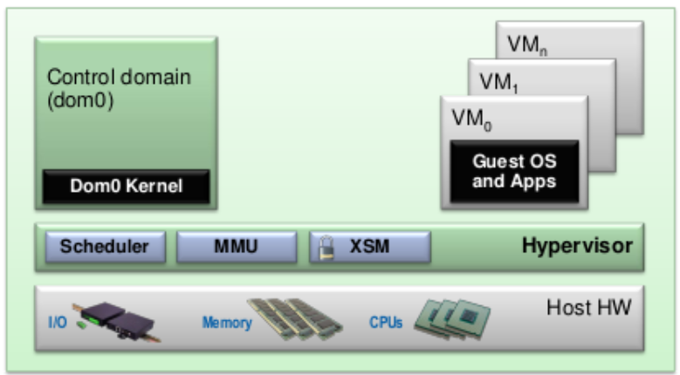
Xen Hypervisor : A Case study
Xen is a Type 1 Hypervisor that implements Hardware-based Full Virtualization, Paravirtualization and Hybride mode.
VM in Xen are called Domains (Dom).
Dom 0 is a special VM that acts as Control Domain.
Dom 0 contains all the device drivers and acts as an Interface to the Hypervisor.

Slide 3
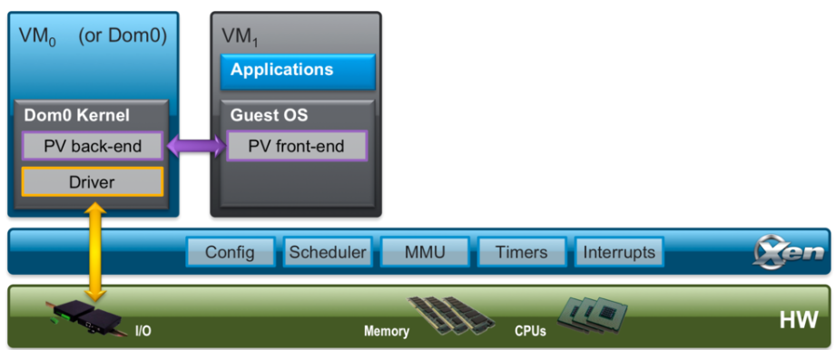
Xen Hypervisor : A Case study
Each paravirtualized datapath consists of two parts:
1) a “backend” that lives in dom0, which provides the virtual device and
2) a “frontend” driver within the guest domain, which allows the guest OS to access the virtual device.
net-back/net-front
blk-back/blk-front

Slide 4
Topics
Container concepts:
Docker and Kubernetes

Slide 5
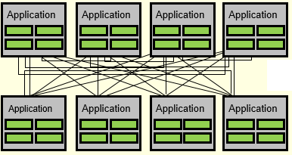

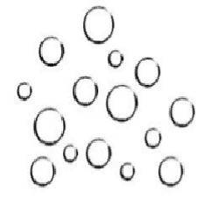
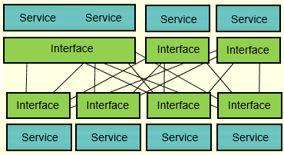
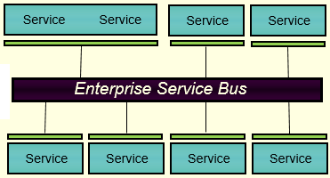
Transition from Monolithic Applications towards Microservices
Monolithic
Application
Microservices

Slide 6
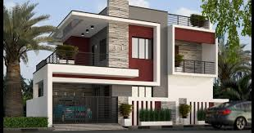
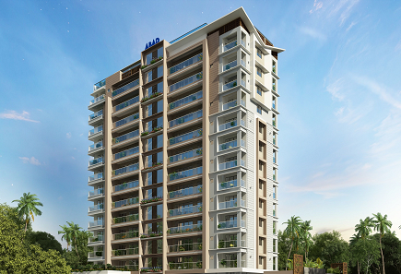
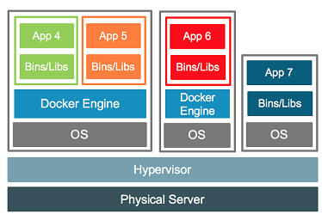
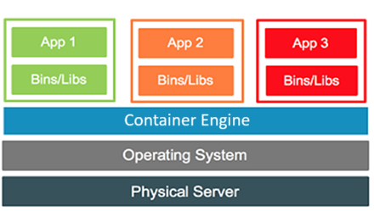
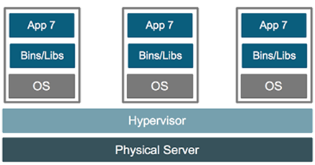
Virtual Machine vs Container for Microservices
Virtual Machine
Container
Microservices

Slide 7
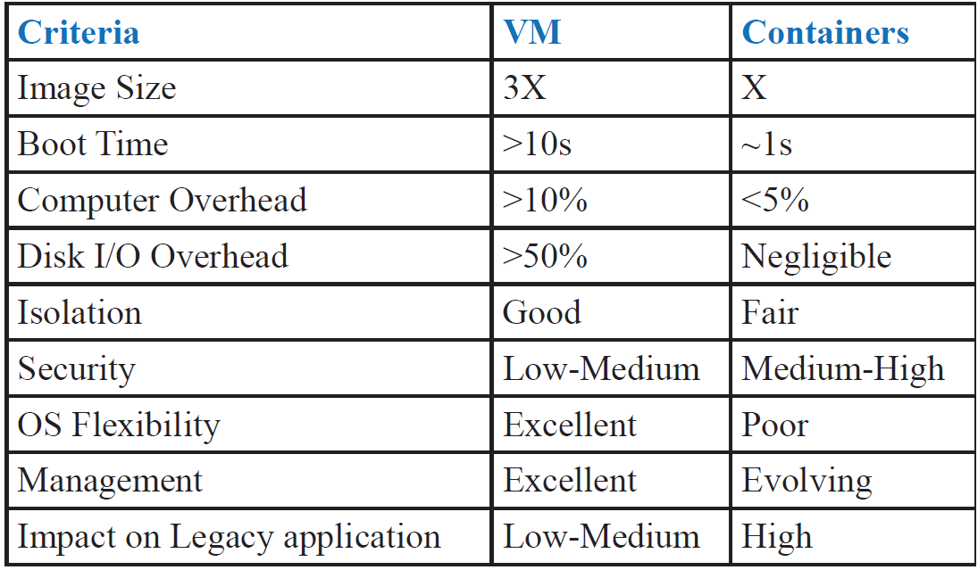
Virtual Machine vs Container for Microservices
Container

Slide 8
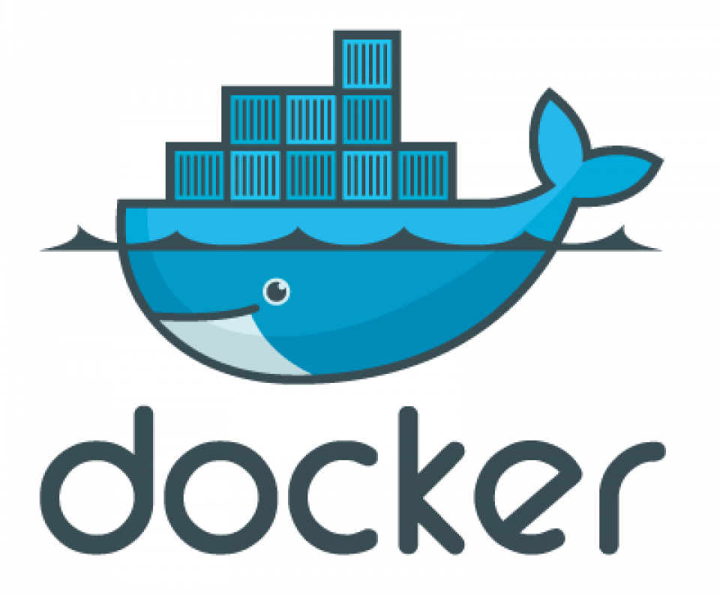
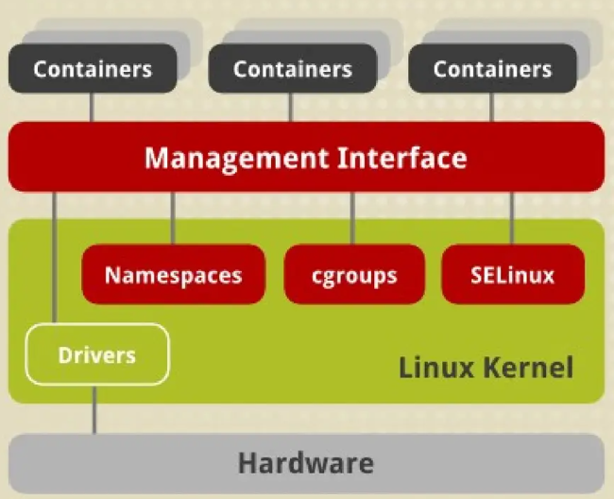
What is Docker?
Docker is the most popular Container Technology.
"Dock" — a place where ships are loaded, unloaded, and prepared. A "Docker" is someone who manages containers at a dock.
Docker Engine is responsible for the Creation, Termination and Management of Container.
Docker is built on top of Linux Container, LXC (2008).
Notes:
LXC uses various Linux namespaces to ensure that processes inside a container:
Only see their own process tree
Have their own network interfaces
Access a separate filesystem
Use separate IPC mechanisms
Cgroups (control groups) limit and monitor how much resources a container can use:
CPU time
Memory usage
Disk I/O
Network bandwidth
Number of processes
SELinux (or AppArmor) controls what the container is allowed to access at a finer level — even within its own namespace.
Restricts file access based on labels
Prevents escalation of privileges
Blocks unauthorized access to host resources

Slide 9
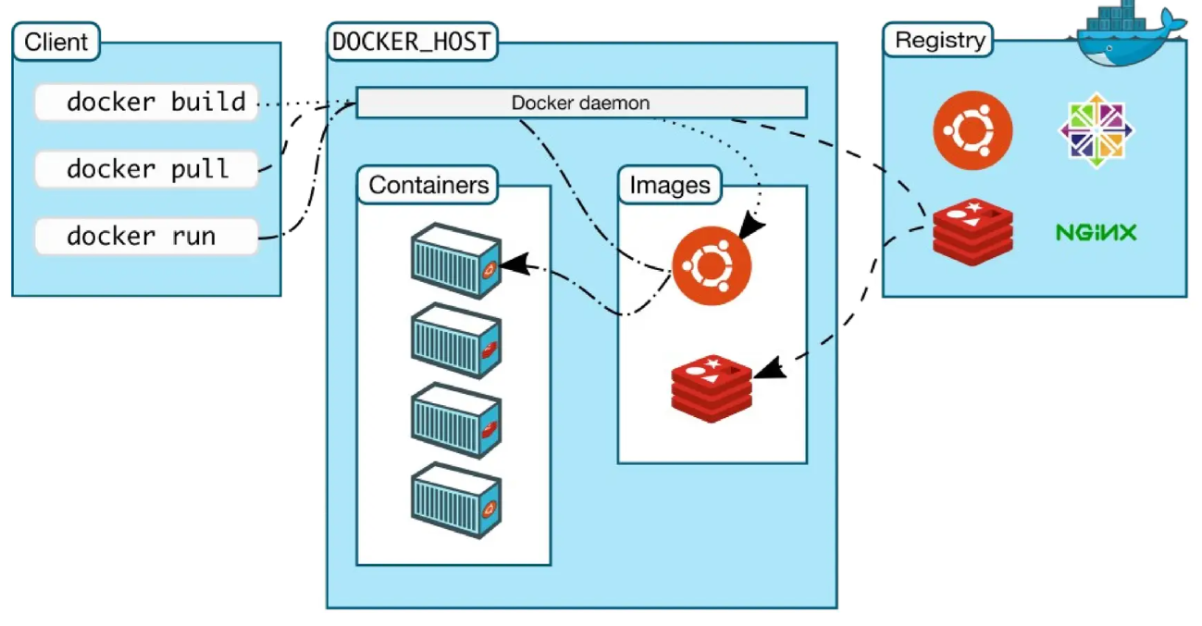
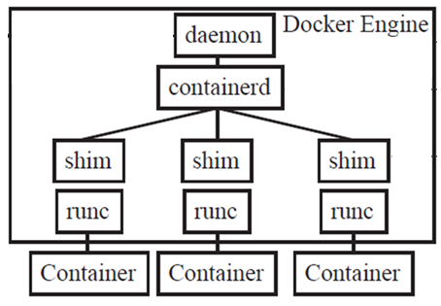
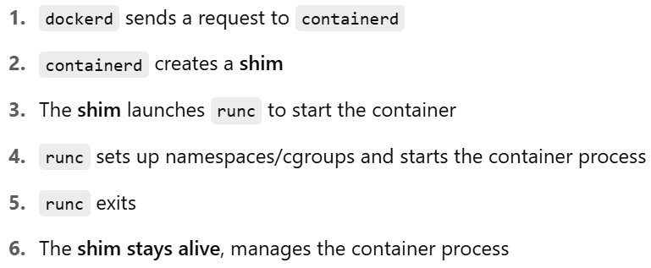
What is Docker?

Slide 10
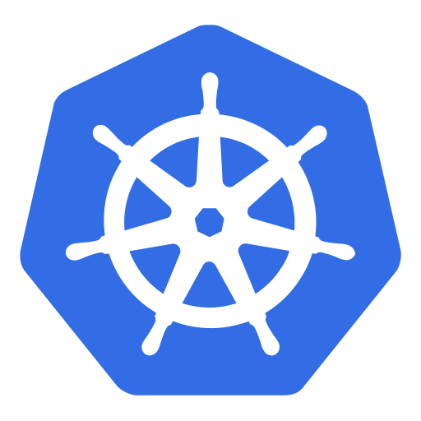
What is Kubernetes or K8s?
Kubernetes is a greek word for helmsman or captain.
Kubernetes = K + 8 letters + s = K8s
Kubernetes is built by Google and is the most popular Container Orchestration Technology .
A container orchestrator is essentially an administrator in charge of operating a fleet of containerized applications.
If a container needs to be restarted or acquire more resources, the orchestrator takes care of it for you.

Slide 11
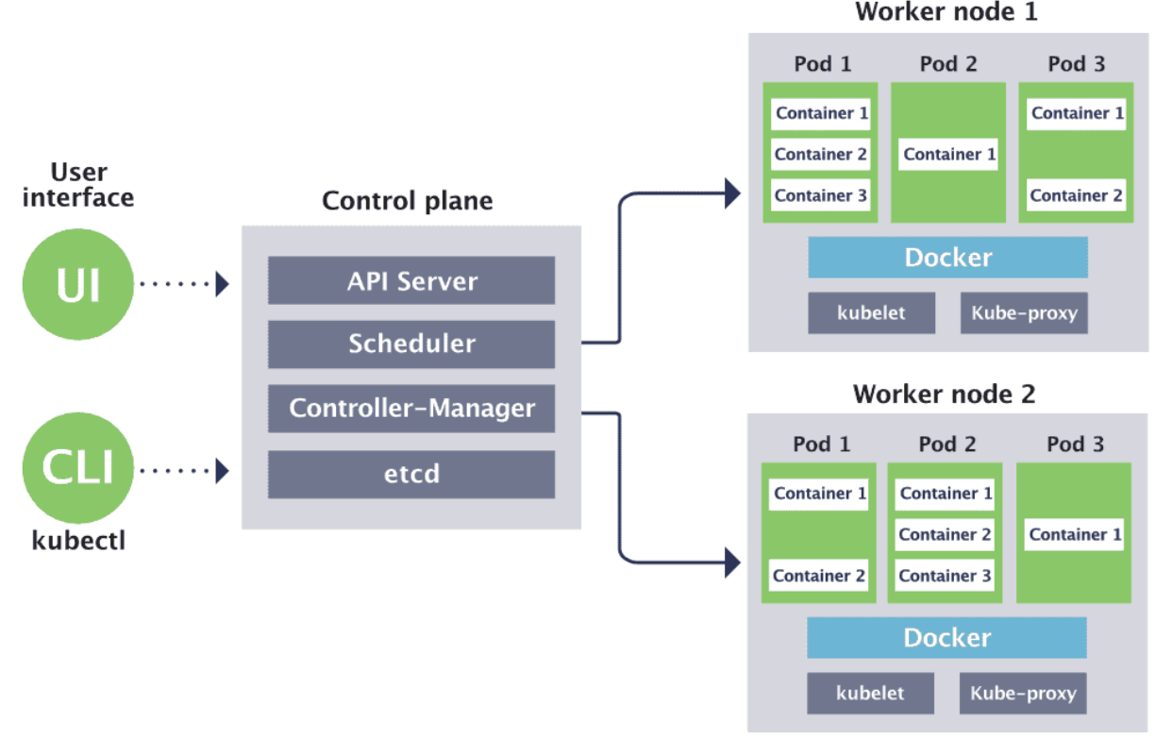
What is Kubernetes or K8s?

Slide 12
What is Kubernetes or K8s?
API Server:
All the components in Kubernetes communicate through API Server
API Server provides a RESTful API to create, update, modify or delete a Kubernetes resource.
Etcd:
Etcd is a daemon for fast, distributed key-value store.
Etcd stores cluster state and metadata.
Etcd monitors the key-value changes and notify the events to API Server.

Slide 13
What is Kubernetes or K8s?
Pods :
A Kubernetes pod is a group of containers, and is the smallest unit that Kubernetes administers.
Pods have a single IP address that is applied to every container within the pod.
Containers in a pod share the same resources such as memory and storage.
Kubernetes will track pod health, replicate and autoscale the pods when needed.

Slide 14
What is Kubernetes or K8s?
Kubelet:
Kubelet is an agent that runs in each node and manages the containers running in a pod.
It registers a node to etcd through API Server.
It starts the containers in a pod when the pod is scheduled by the scheduler to that node.
Continuously monitor the containers and report their status to etcd through API Server.

Slide 15
What is Kubernetes or K8s?
Kube-proxy:
Kube-proxy is responsible for routing network traffic to the desired pods for a service.
It provides seamless connectivity among the pods and among the nodes.
It abstract away pod IPs (which are dynamic)
It also load balances the traffic across multiple pods.

Slide 16
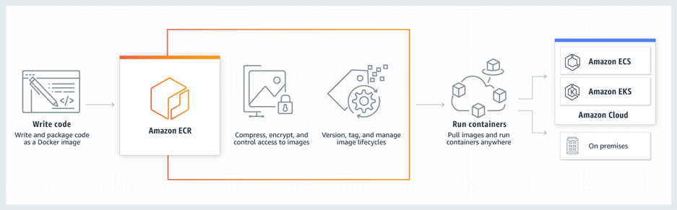
Containers in AWS

Slide 17
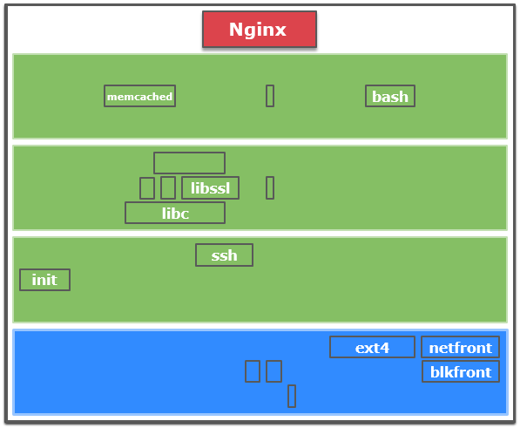
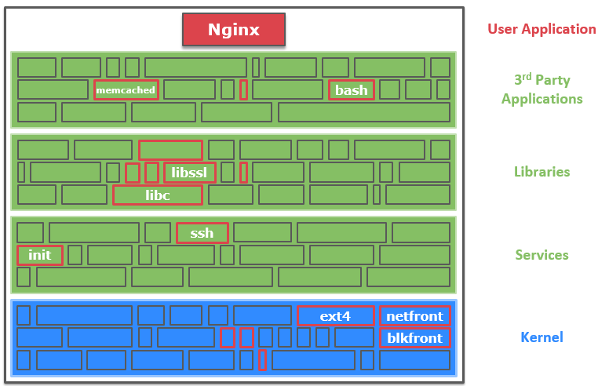

Unikernel for Microservices
Unikernels are specialised, single address space machine images constructed by library operating systems
Similar to One VM for One Service
Guest OS
Virtualized
Hardware
Microservices
Virtual Machine
Virtual Machine Monitor
(Hypervisor)
Blade Server
Physical
Hardware

Slide 18
Unikernel for Microservices
Unikernels are specialized, single address space machine images constructed by library operating systems
Similar to One VM for One Service
Advantages
Few kilobytes in size, so very fast to boot.
No context switch
Runs on hypervisor, container or bare metal
Small attack surface

Slide 19
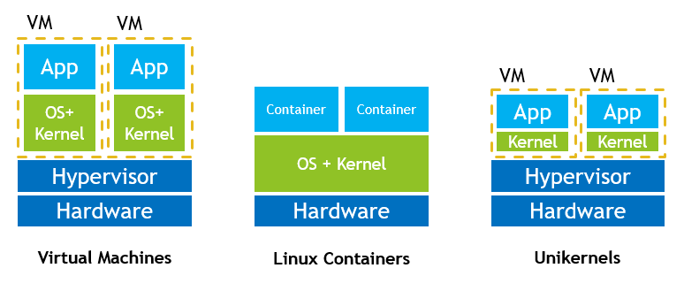
VM vs Container vs Unikernel

Slide 20
Thank You for Listening
Questions?

